Slide 1
Global Pharmacy Sales Analysis (2020–2025)
Power BI Dashboard | Excel | Data Analytics Project
Christina kumar
June 2026

Slide 2
OBJECTIVE
Analyse global pharmacy sales data to identify revenue trends, inventory utilization, product performance, and opportunities to improve business decisions.

Slide 3
Project Workflow
Tools Used
Microsoft Excel: Data cleaning, validation, Pivot Tables, Pivot Charts, and exploratory data analysis.
Power Query: Imported and transformed the dataset for analysis.
Power BI: Built an interactive dashboard with KPIs, DAX measures, slicers, and business visualizations.
Data Source
Source: Kaggle
Dataset: Global Pharmacy Sales (2020–2025) daily dataset
Format: CSV
Key Variables: Country, Medicine, Revenue, Units Sold, Unit Price, Stock Level, Expiry Days Remaining, etc.
Analytical Workflow
Imported and explored the raw dataset in Excel.
Performed data cleaning and validation using Excel.
Created Pivot Tables and Pivot Charts to identify trends and verify key metrics.
Loaded the cleaned dataset into Power BI using Power Query.
Developed DAX measures and for revenue, capital utilization, and unsold inventory.
Built an interactive dashboard with filters and business insights.
Presented findings and recommendations based on the analysis.

Slide 4
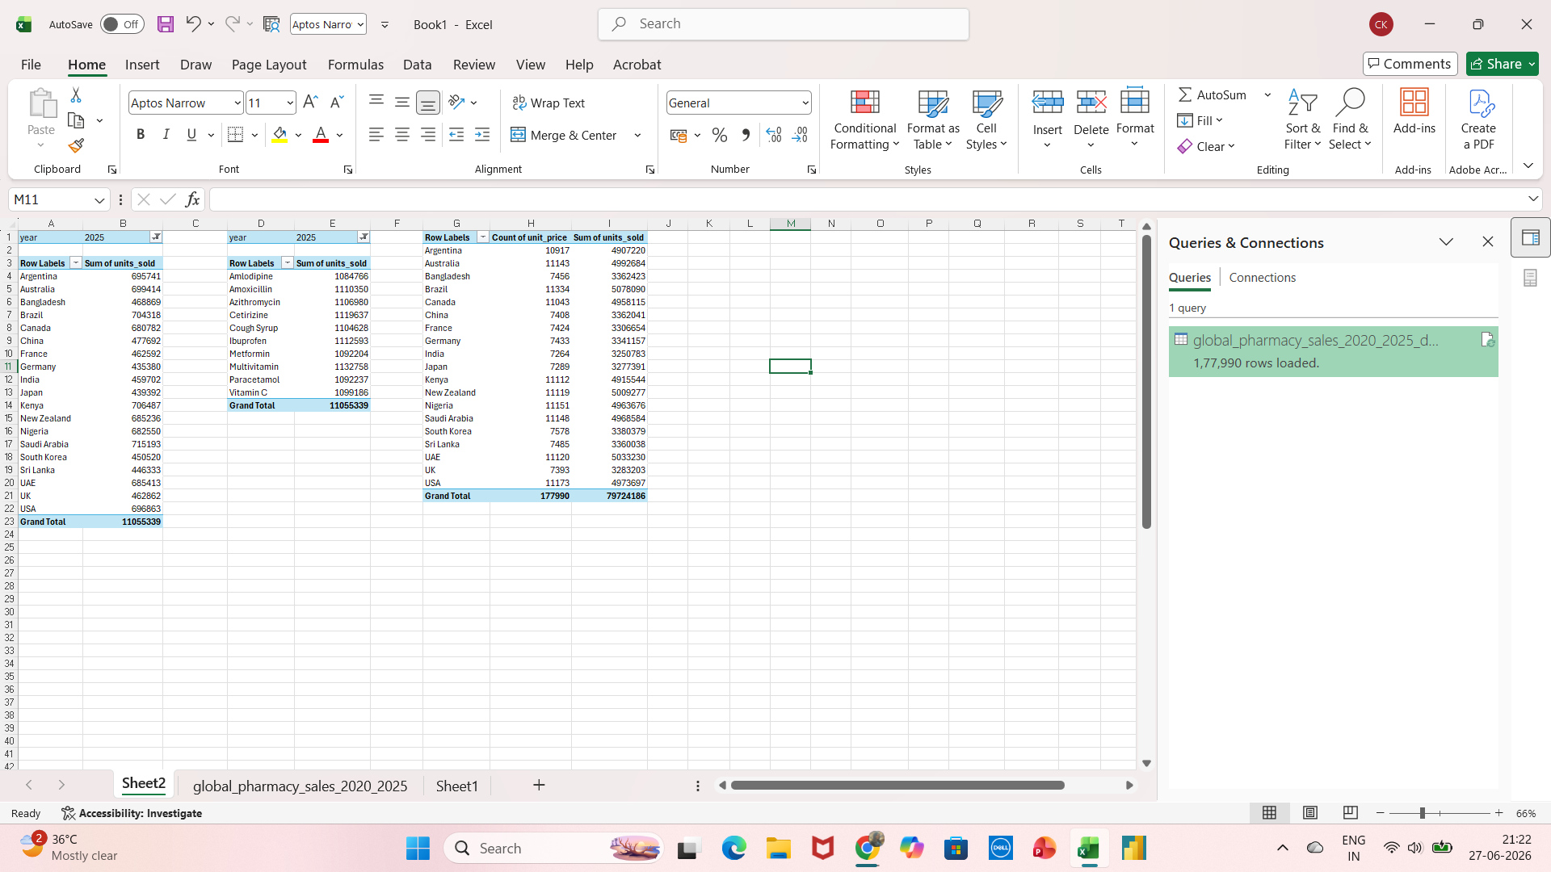
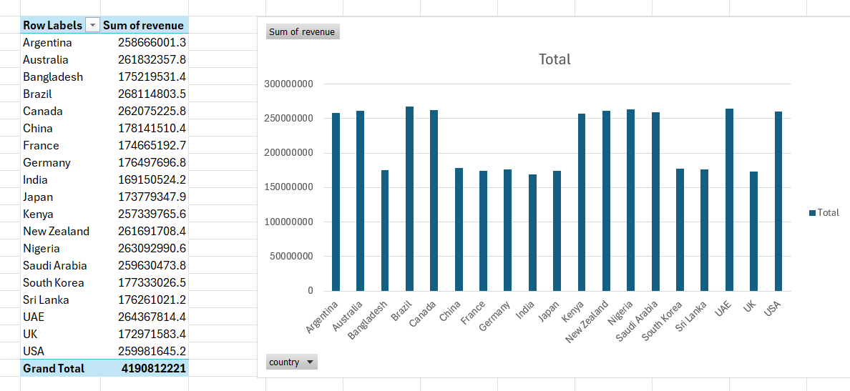

Slide 5
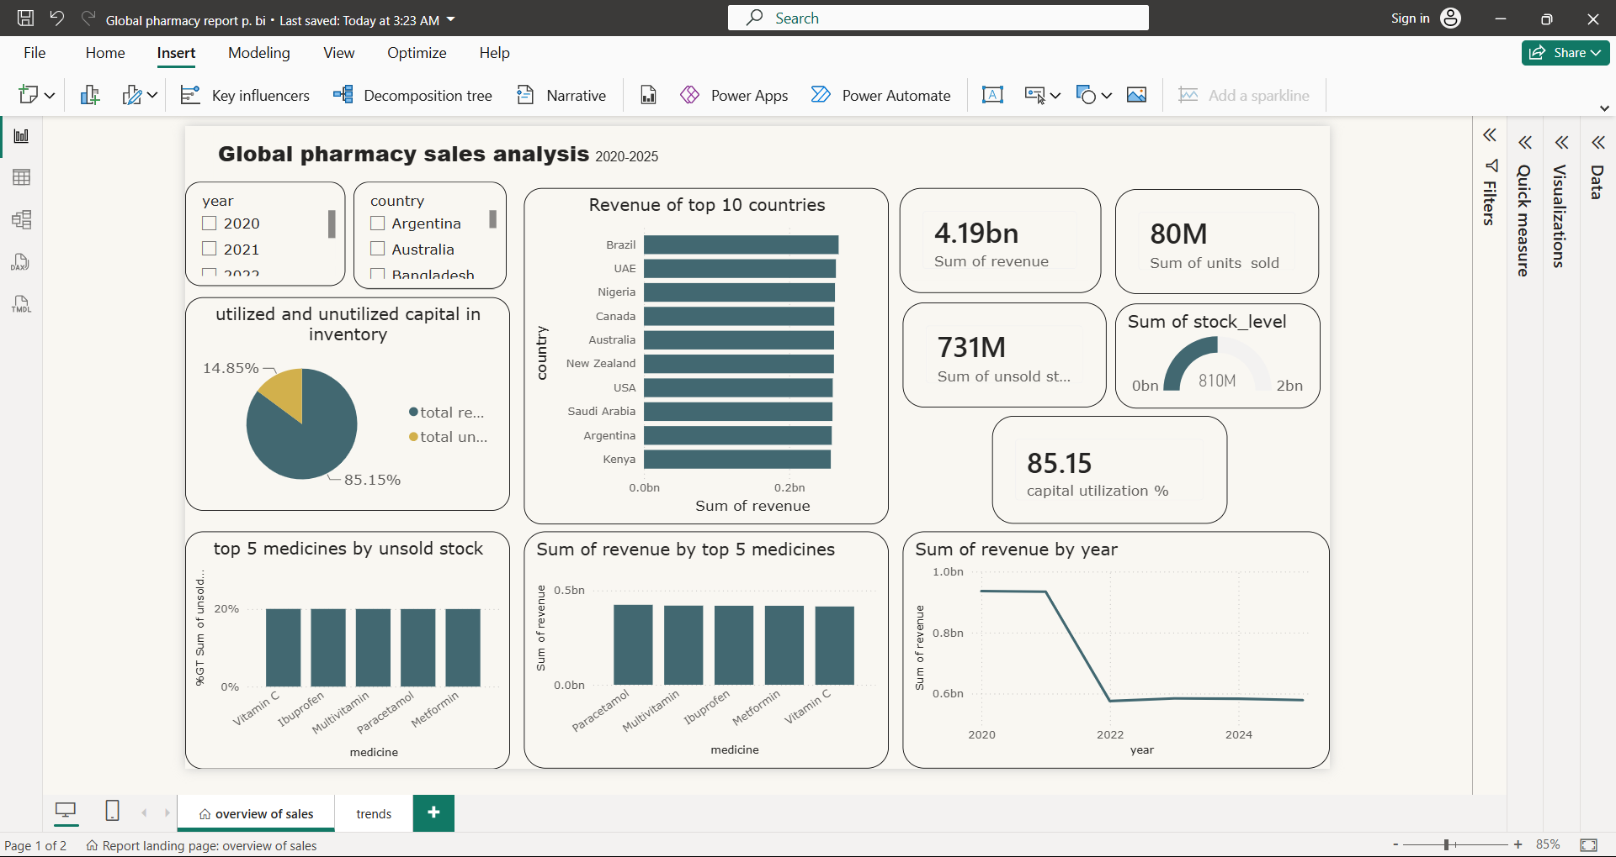
Dashboard Features
Interactive Year & Country slicers
Capital utilization analysis
Top-performing countries
Top-performing medicines
Unsold inventory analysis
Revenue trend over time

Slide 6
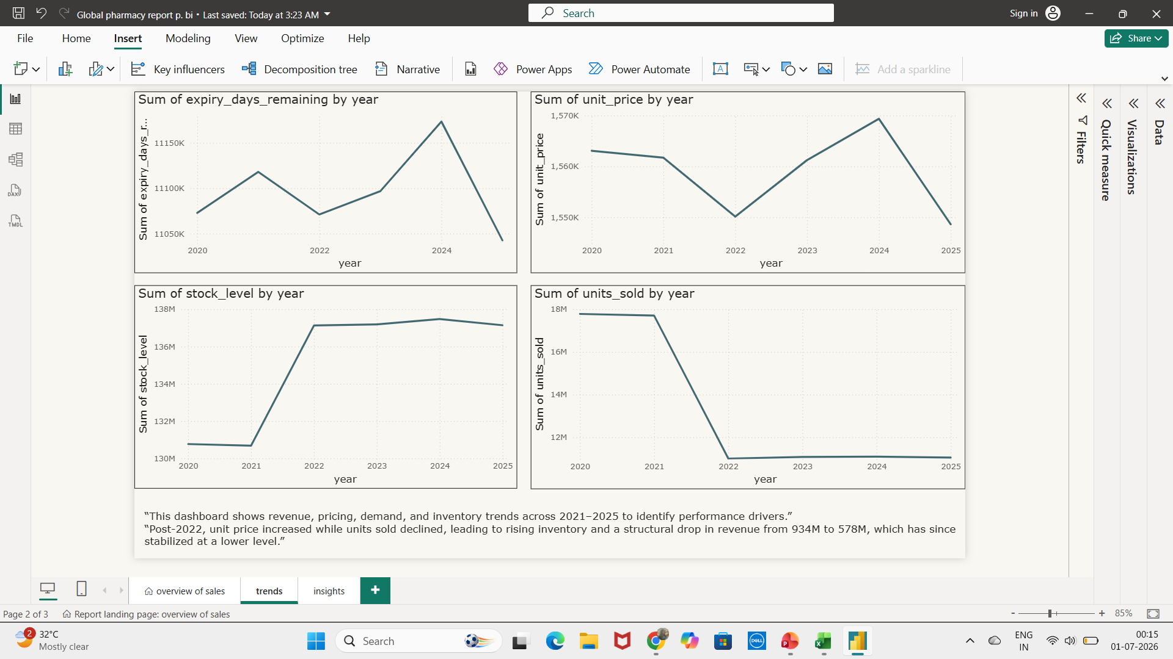
Key Trends
Revenue declined sharply after 2021 before stabilizing.
Units sold followed a similar downward trend.
Inventory levels increased despite declining sales.
Unit price showed year-to-year variation, with the highest values recorded in 2024.
Expiry days remaining varied across years, with the highest value in 2024 followed by a decline in 2025.

Slide 7
Key Business Insights
Revenue: 4.19B
Units Sold: 80M
Capital Utilization: 85.15%
Unsold Inventory: 731M
Brazil generated the highest revenue.
Top revenue medicines: Paracetamol, Multivitamin, Ibuprofen, Metformin, Vitamin C.
Demand slowed after 2021 while inventory continued to accumulate.
Stable pricing indicates revenue decline was primarily volume-driven.
The peak in average unit price during 2024 did not coincide with a further decline in sales, indicating that pricing alone may not explain the overall sales trend.
Business Recommendations
Reduce excess inventory for slow-moving medicines.
Prioritize high-performing markets.
Optimize procurement based on sales trends.
Strengthen inventory monitoring to improve capital utilization.

Slide 8
Skills Demonstrated
Technical Skills
Microsoft Excel
Pivot Tables
VLOOKUP/XLOOKUP
Power Query
Power BI
Created DAX measures to calculate:
Total Revenue
Total Units Sold
Total Unsold Stock Value
Capital Utilization Percentage
Analytical Skills
Trend Analysis
Inventory Analysis
Business Insight Generation
Data Visualization
Conclusion
This dashboard transformed raw pharmacy sales data into actionable business insights by identifying revenue patterns, inventory inefficiencies, and market performance. The analysis demonstrates how data visualization can support strategic decision-making in pharmaceutical supply chain and sales management.

